Slide 1
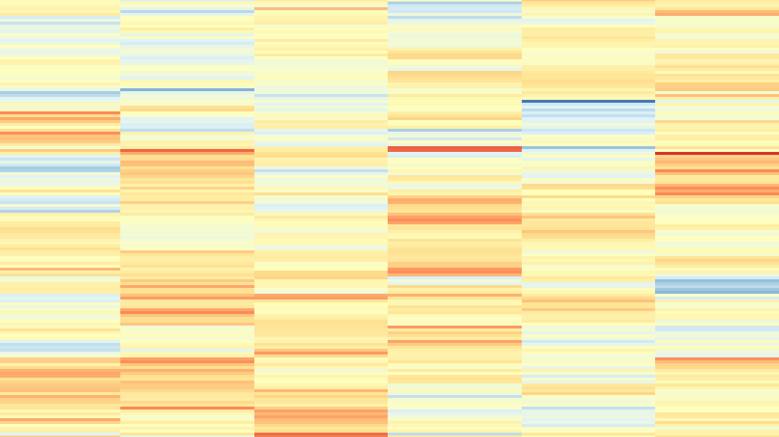
Differential Gene Expression
NST Part II BBS Bioinformatics
Feb 27 2025
Dr Katy Brown
Firth Lab, Virology Division, Department of Pathology
kab84@cam.ac.uk

Slide 2
Lecture Plan
Principles
Techniques
Microarrays
RNA-Seq
RNA-Seq library preparation:
RNA selection/Depletion
Fragmentation
cDNA synthesis
Sequencing
Read Mapping
Counting Reads​
Pre-visualisation transformations​
Visualisation​
Heatmaps​
Principal Components Analysis​

Slide 3
Lecture Plan
Principles
Techniques
Microarrays
RNA-Seq
RNA-Seq library preparation
RNA selection/Depletion
Fragmentation
cDNA synthesis
Sequencing
Read Mapping
Counting Reads​
Pre-visualisation transformations​
Visualisation​
Heatmaps​
Principal Components Analysis​

Slide 4
Differential Expression
Identify genes which are significantly more expressed in one condition than another
e.g.
Disease vs control
Treated vs untreated
Infection, disease, developmental timepoints

Slide 5
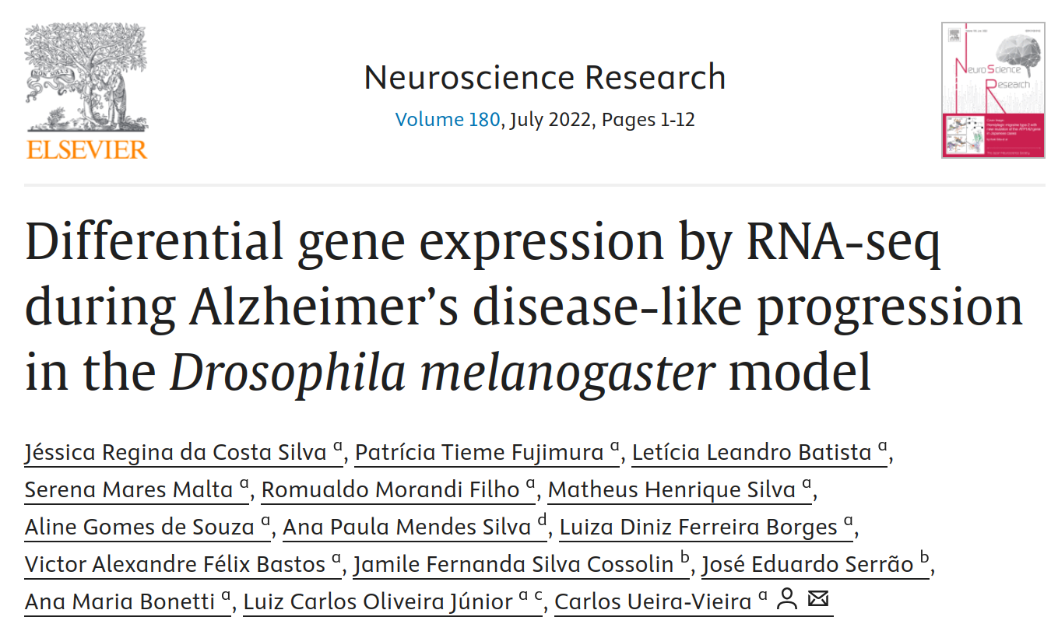


Examples
https://doi.org/10.3390/ijms22136980
https://doi.org/10.1016/j.neures.2022.02.003
https://doi.org/10.1007/s00438-021-01841-7

Slide 6
Principles
Identify genes which are significantly more expressed in one condition than another
Uses transcription as a proxy for expression – assumes that the transcripts are equally translated
Gene expression is actually controlled by both transcription and translation – just because a gene is more transcribed, doesn't mean there is more of the protein

Slide 7
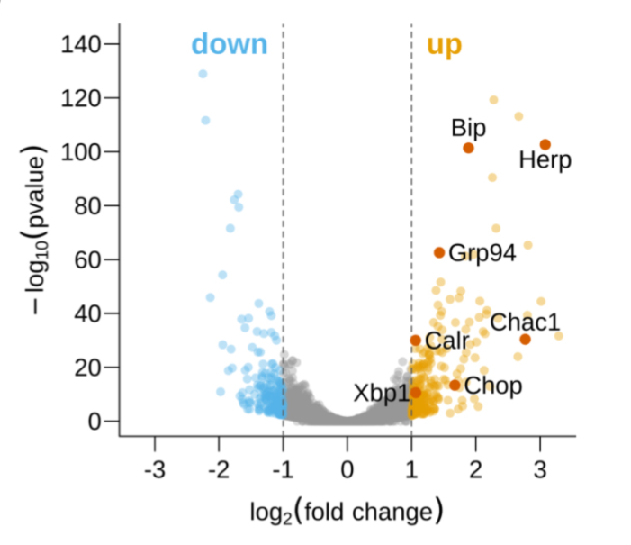
Principles
Based on analysis of thousands of genes
Requires a statistical approach – gene expression will never be 100% identical, even between technical replicates
Based on identification of outliers

Slide 8
Principles
Outcome:
List of significantly differentially expressed genes
Identify specific genes of interest
Are genes with any specific function are more common?
Are genes in any specific pathway more common?

Slide 9
Lecture Plan
Principles
Techniques
Microarrays
RNA-Seq
RNA-Seq library preparation
RNA selection/Depletion
Fragmentation
cDNA synthesis
Sequencing
Read Mapping
Counting Reads​
Pre-visualisation transformations​
Visualisation​
Heatmaps​
Principal Components Analysis​

Slide 10
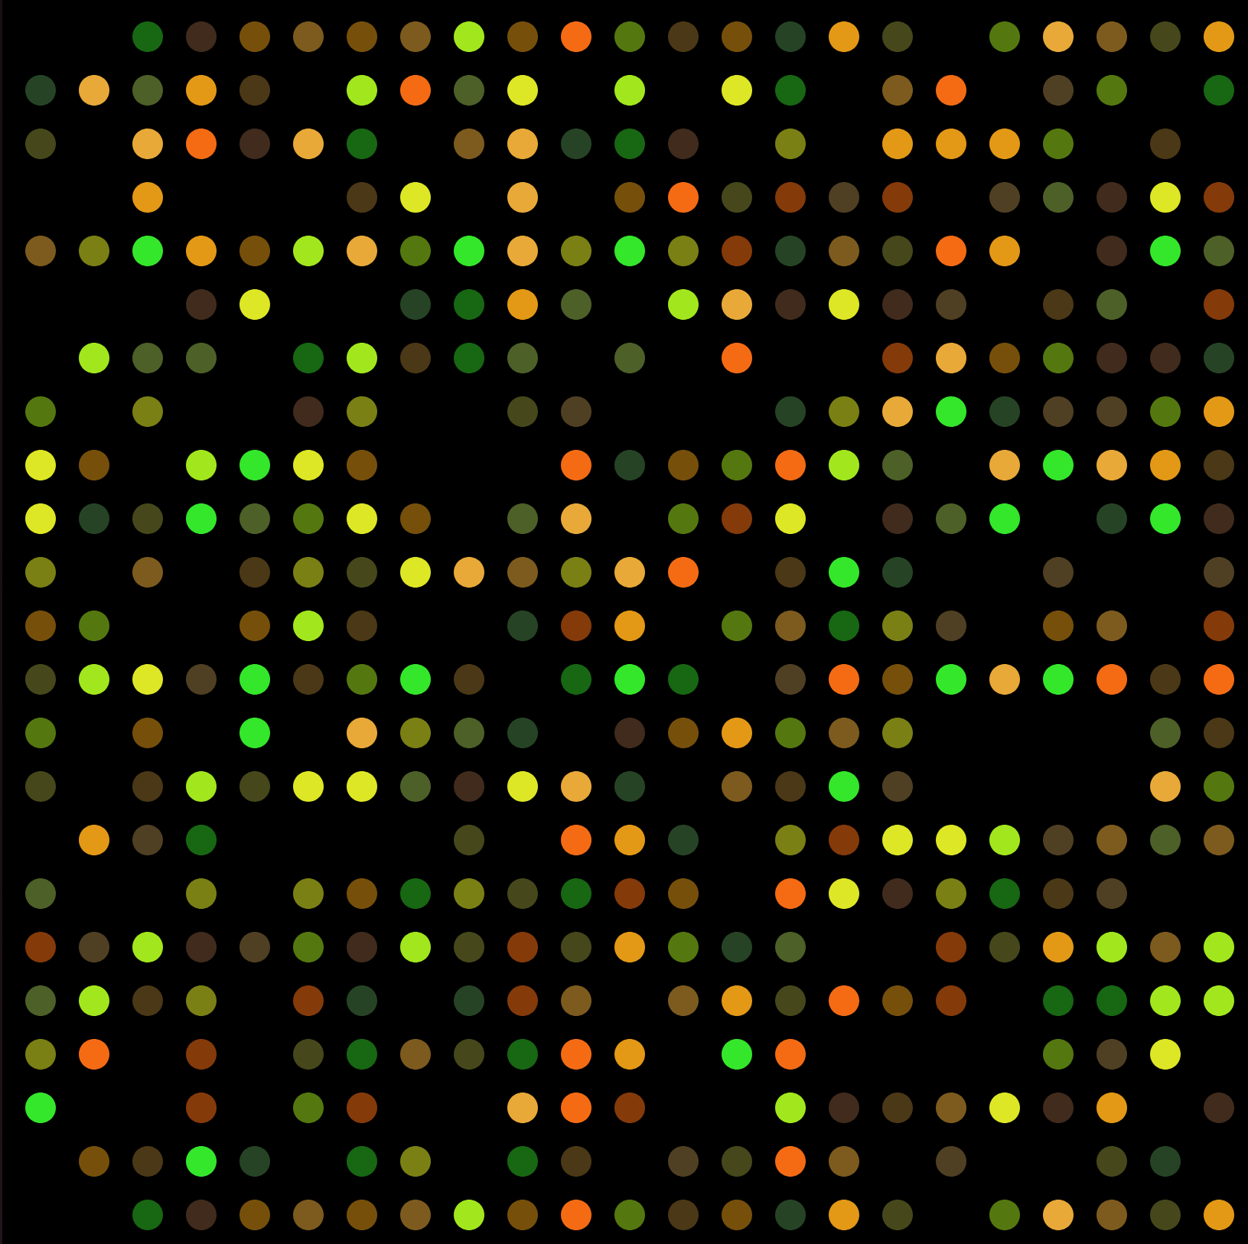
Microarrays
Used to measure the expression of a large number of genes simultaneously.
RNA-seq is now more commonly used.
Look at specific target genes.
Can only be used with organisms with well-annotated genomes.

Slide 11
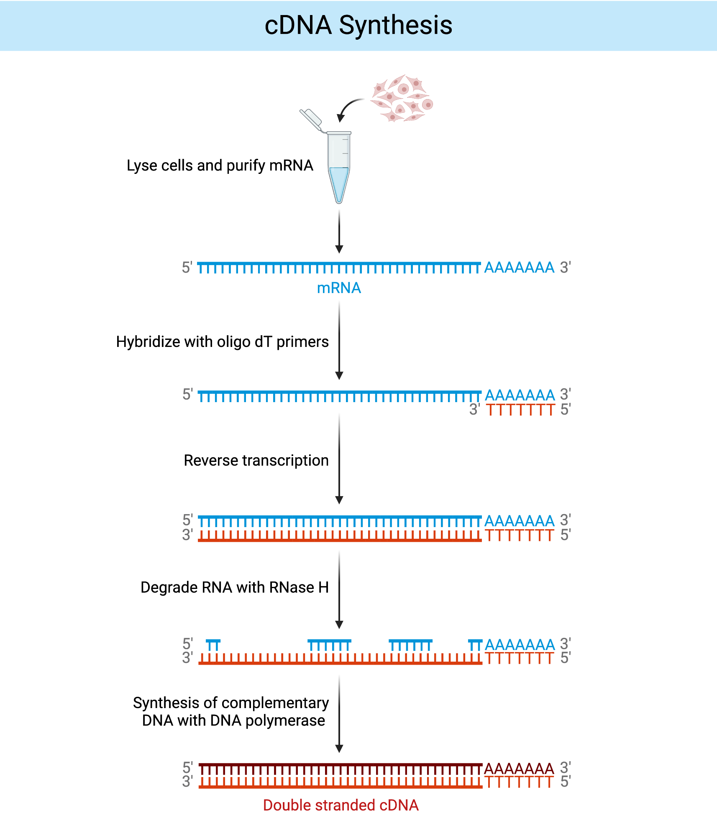
Microarrays
RNA is extracted from a sample
RNA is (usually) converted into cDNA, via reverse transcription
cDNA is fluorescently labelled
Each of the conditions you compare is labelled with a different tag
https://app.biorender.com/biorender-templates/t-641db7a2dd8d302fe26bf9ea

Slide 12
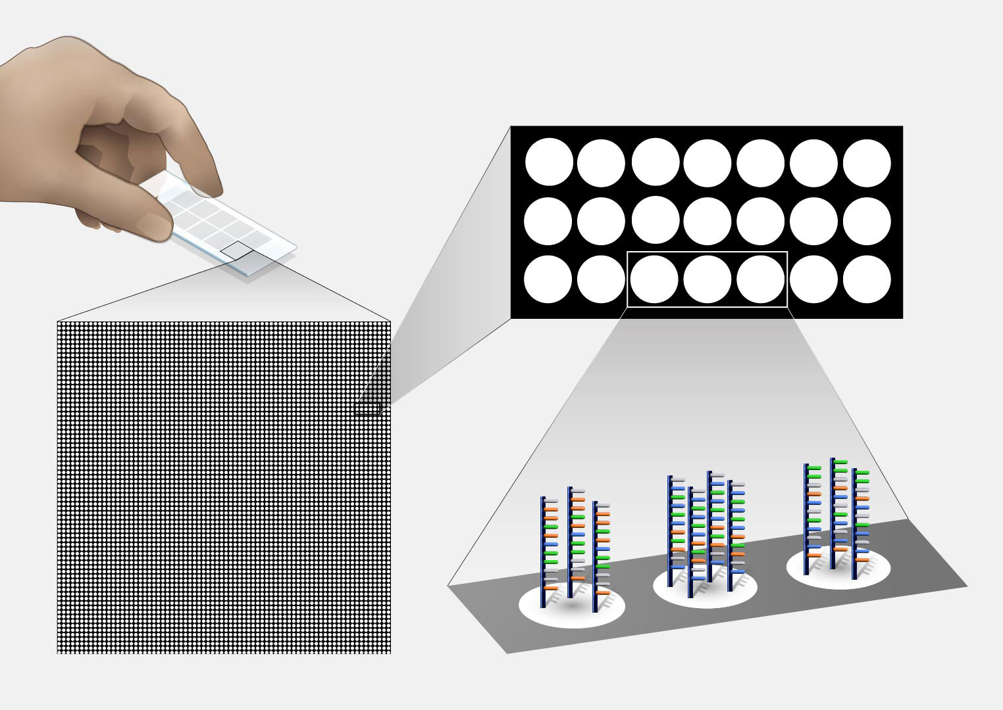
Microarrays
The microarray is a glass slide or silicon chip with thousands of DNA probes in a grid pattern.
DNA probes are typically 20-70 nucleotides.
Each probe is designed to match a specific gene or exon, with multiple representatives of each gene
Location of each gene on the array is known.
https://www.genome.gov/sites/default/files/media/images/2022-05/Microarray-technology.jpg

Slide 13
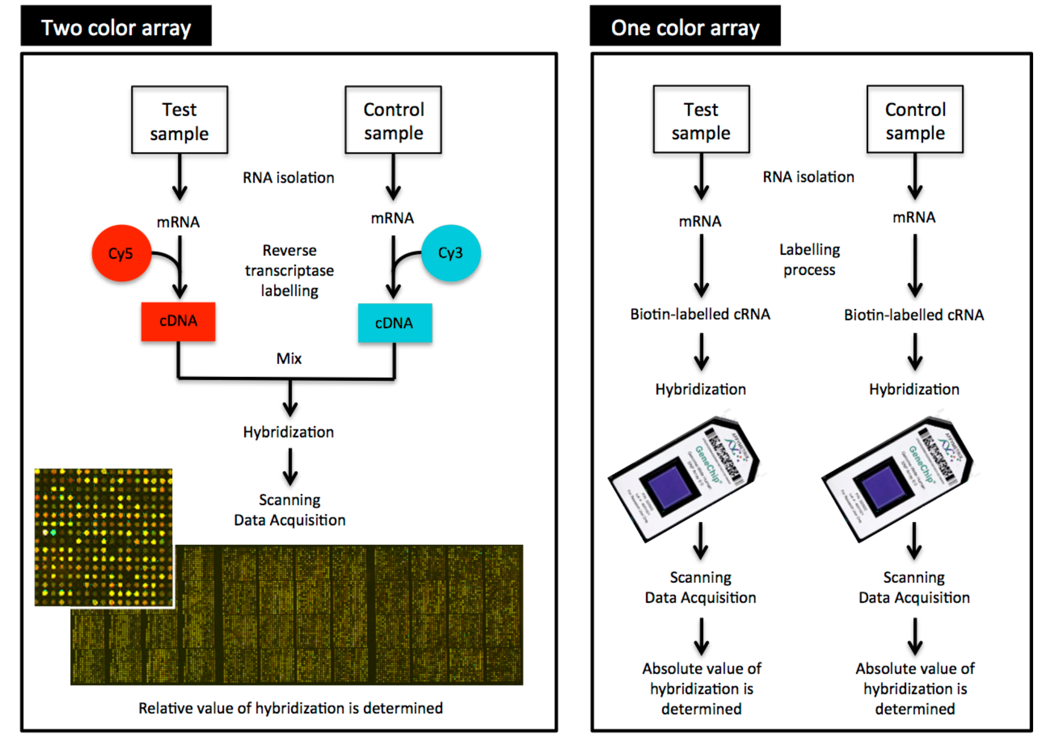
Microarrays
https://www.ebi.ac.uk/training/online/courses/functional-genomics-ii-common-technologies-and-data-analysis-methods/microarrays/

Slide 14
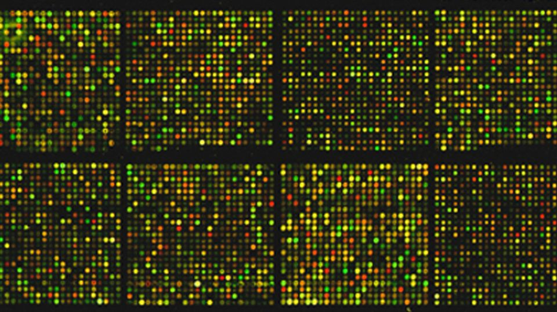
Microarrays
Samples are placed in a fluorescent laser scanner.
Specific wavelengths of light are excited and measured.
The results are output as an image, where each spot corresponds to a probe and brightness correlates with gene expression.
https://assets.technologynetworks.com/production/dynamic/images/content/368539/innovations-and-versatility-in-modern-microarray-technology-368539-960x540.jpg?cb=12075259
Various software can be used to convert this image into a numerical matrix​.

Slide 15
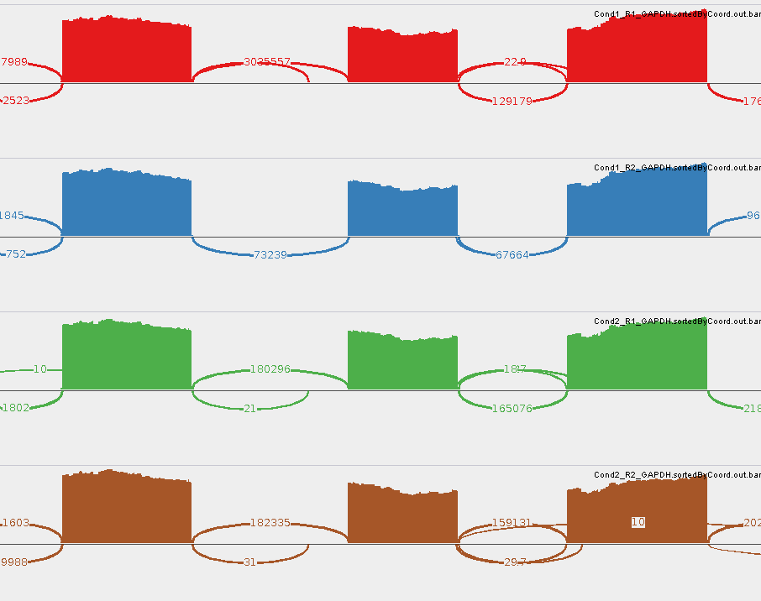
RNA-Seq
Application of NGS techniques to cDNA molecules.
Reveals the presence and quantity of RNA molecules in a sample.

Slide 16
Lecture Plan
Principles
Techniques
Microarrays
RNA-Seq
RNA-Seq library preparation
RNA selection/Depletion
Fragmentation
cDNA synthesis
Sequencing
Read Mapping
Counting Reads​
Pre-visualisation transformations​
Visualisation​
Heatmaps​
Principal Components Analysis​

Slide 17
RNA-Seq Library Preparation
Extract RNA from the sample
RNA selection / depletion
Fragmentation
cDNA synthesis
Sequencing

Slide 18
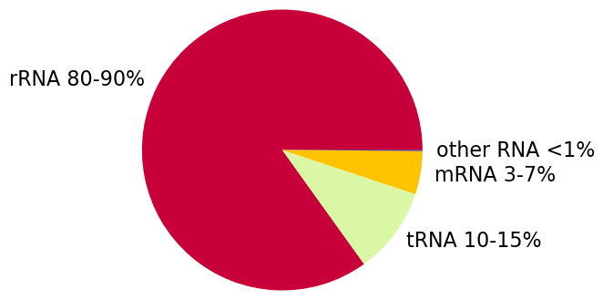
RNA-Seq Library Preparation
Extract RNA from the sample
RNA selection / depletion
If you sequence all of the RNA in a sample, a large proportion will be ribosomal RNA
Proportion of RNA in a mammalian cell by mass
Palazzo, A. F., & Lee, E. S. (2015). Non-coding RNA: what is functional and what is junk?. Frontiers in genetics, 6, 2.
doi.org/10.3389/fgene.2015.00002

Slide 19
RNA-Seq Library Preparation
rRNA (structural RNA which is the the primary component of ribosomes) is usually not our main interest when performing RNA seq
Most commonly want to identify aspects of protein coding genes:
mRNA mapping reads
May also be interested in non-coding RNAs.

Slide 20
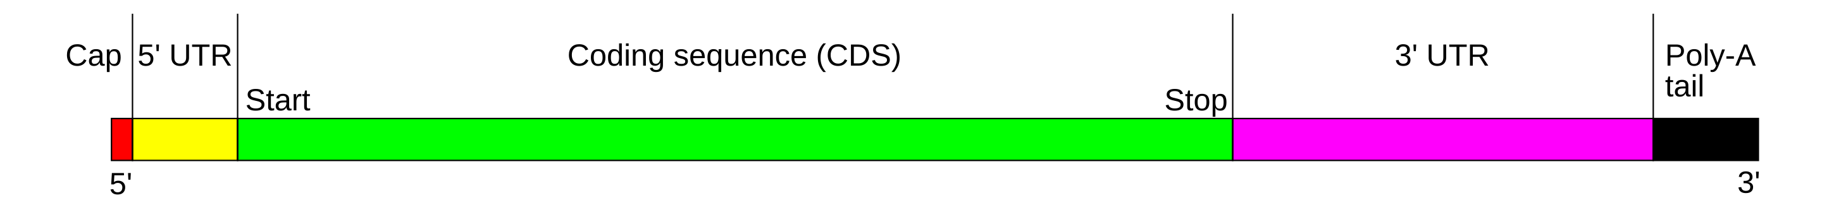
RNA Selection / Depletion
Common to increase in proportion of mRNA in one of two ways:
PolyA selection
Ribosome depletion
PolyA selection
Selects for polyadenylated transcripts – usually mRNAs

Slide 21
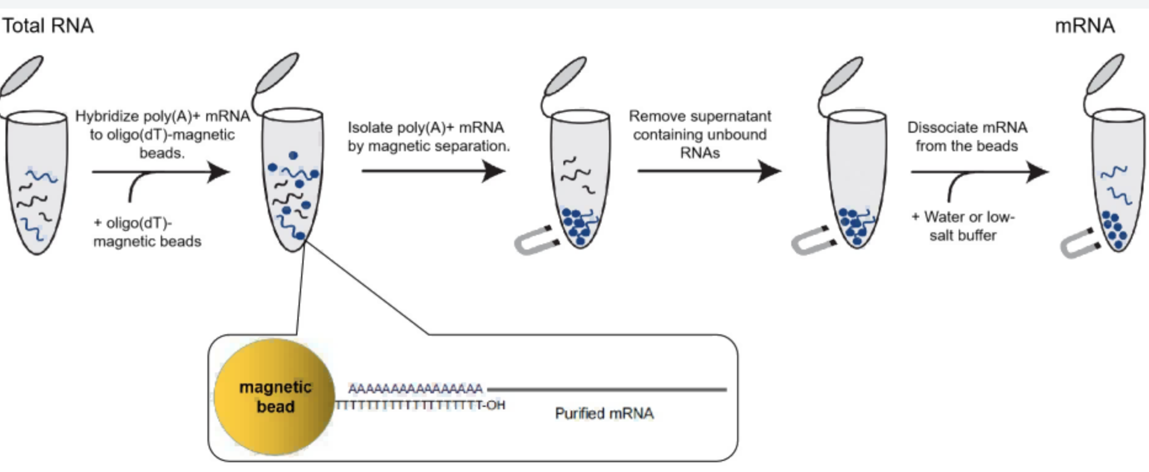
PolyA Selection
PolyA tail - string of A nucleotides at the 3' end of the transcript.
PolyA selection protocols use oligo dTs – strings of T nucleotides – to hybridise to these.
Hybridised RNAs are isolated
https://www.yeasenbio.com/blogs/ngs/various-types-of-magnetic-beads-in-ngs-dna-rna-mrna-magnetic-beads

Slide 22
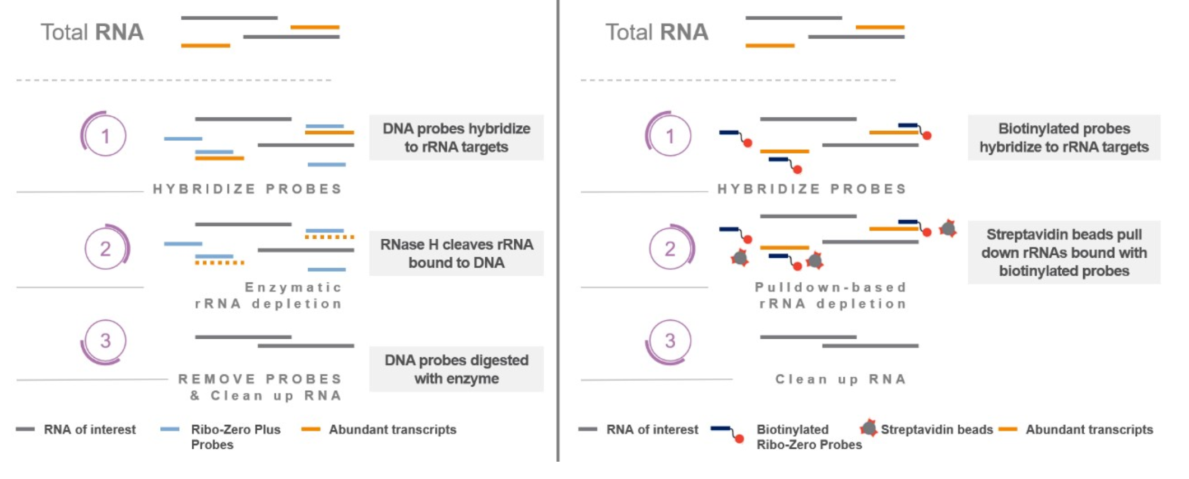
Ribosome Depletion
Uses oligos designed to bind ribosomal RNA
https://support.illumina.com.cn/bulletins/2021/09/rrna-depletion-using-illumina-ribo-zero-plus-.html

Slide 23
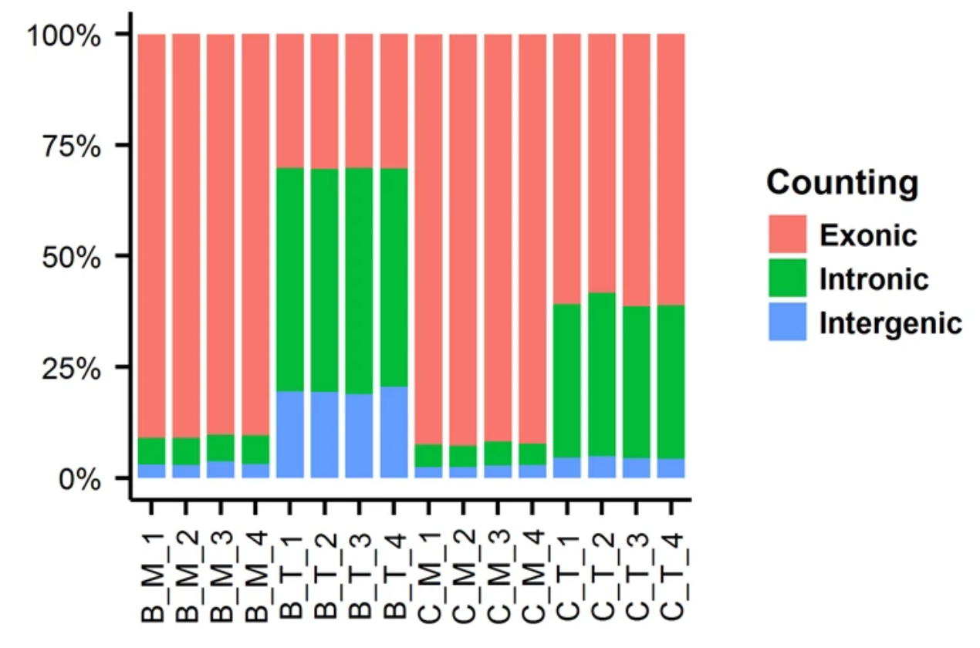
Comparison
PolyA selection – more reads mapping to protein coding exons.
Ribosome depletion – more intronic and intergenic reads.
Ribosome depletion is species specific.
Best option depends on the use case.
PolyA blood
RiboD blood
PolyA colon
RiboD colon
https://www.nature.com/articles/s41598-018-23226-4

Slide 24
Fragmentation
Extract RNA from the sample​
RNA selection / depletion
Fragmentation
Break the sequences down to an appropriate length for the sequencing machine.
Usually enzymatic fragmentation or chemical hydrolisation
Usually fragment RNA, can also fragment cDNA

Slide 25
cDNA synthesis
Extract RNA from the sample​
RNA selection / depletion
Fragmentation
cDNA synthesis
Convert RNA into cDNA using reverse transcriptase

Slide 26
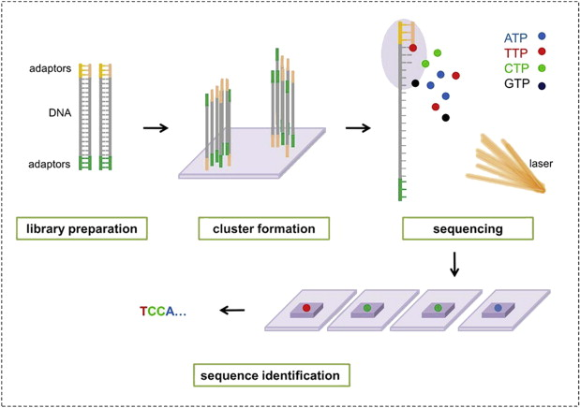
Sequencing
Extract RNA from the sample​
RNA selection / depletion
Fragmentation
cDNA synthesis
Sequencing
High throughput sequencing of the resulting cDNA.
https://www.sciencedirect.com/topics/immunology-and-microbiology/illumina-dye-sequencing

Slide 27
Lecture Plan
Principles
Techniques
Microarrays
RNA-Seq
RNA-Seq library preparation
RNA selection/Depletion
Fragmentation
cDNA synthesis
Sequencing
Read Mapping
Counting Reads​
Pre-visualisation transformations​
Visualisation​
Heatmaps​
Principal Components Analysis​

Slide 28
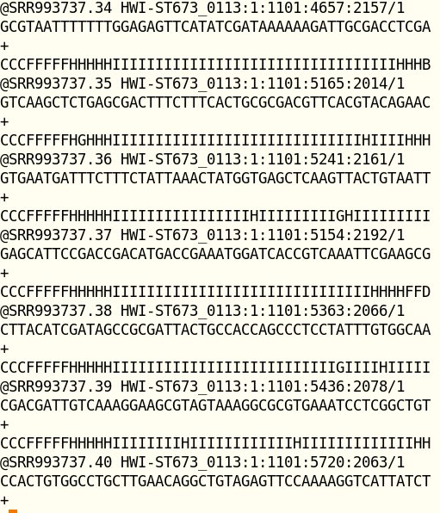
FASTQ Files
Output of high throughput sequencing – FASTQ file
Shows the sequence of each cDNA fragment
Doesn't show where in the genome the reads come from

Slide 29
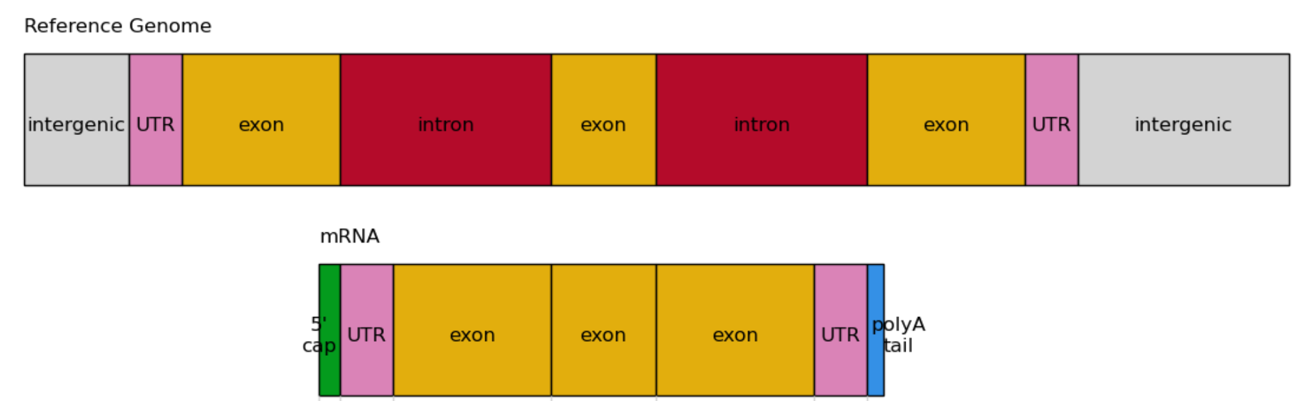
Read Mapping
When mapping RNA-seq reads, we need to take into account possible splice junctions.
Our reads represent fragments of mRNAs (hopefully).
Reference sequence is genomic DNA.

Slide 30
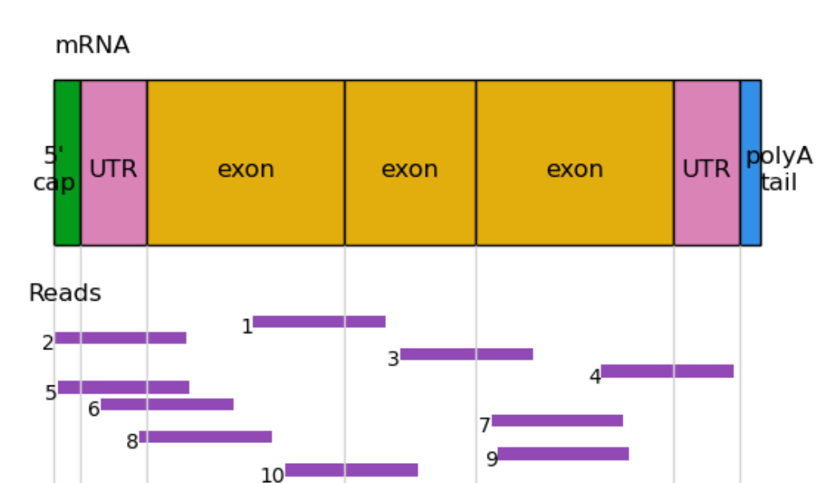
Read Mapping
Our reads represent fragments of mRNAs.​

Slide 31
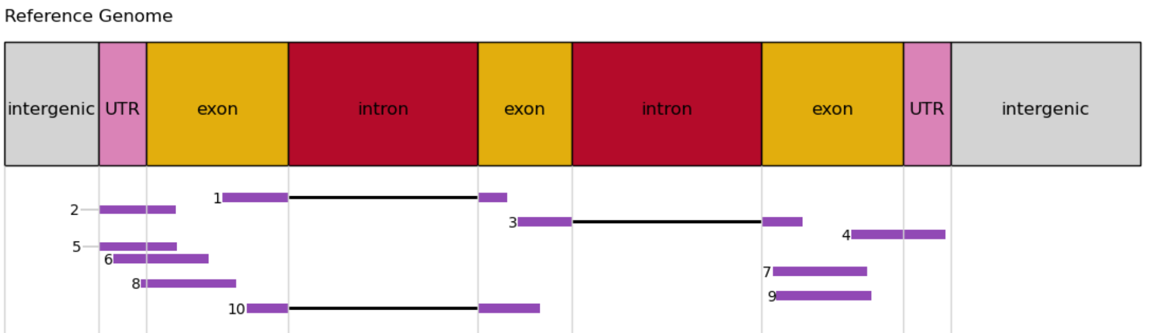
Splice Junctions
We usually map to the genome, rather than to transcripts – so we need to account for splice junctions.

Slide 32
Genome Annotations
Provide our mapping tool with a genome annotation.
Usually in GTF format.
Sometimes referred to as gene models.
Specifies how the gene relates to the transcript – contains (at least) positions of genes, transcripts and exons.

Slide 33
Read Mapping
The software can then map the reads, taking into account the splice junctions.

Slide 34
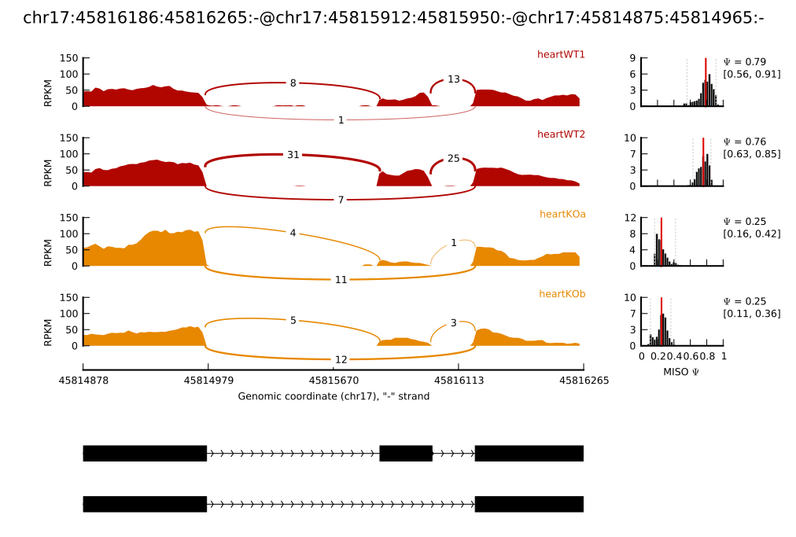
Sashimi Plots
Read coverage across splice junctions is sometimes visualised as a sashimi plot.
The numbers on the lines represent the number of reads spliced across the junction
https://miso.readthedocs.io/en/fastmiso/sashimi.html

Slide 35
De Novo SJ Annotation
Splice junctions can also be identified de novo based only on where the reads split.
Allow reads to have any junction at any position and identify common junctions.

Slide 36
Splice-Aware Alignment
Some common tools for splice-aware alignment:
STAR (Spliced Transcripts Alignment to a Reference)
Dobin A, Davis CA, Schlesinger F, et al. STAR: ultrafast universal RNA-seq aligner. Bioinformatics. 2013;29(1):15-21. doi:10.1093/bioinformatics/bts635
HISAT2 (Hierarchical Indexing for Spliced Alignment of Transcripts)
Kim D, Paggi JM, Park C, Bennett C, Salzberg SL. Graph-based genome alignment and genotyping with HISAT2 and HISAT-genotype. Nat Biotechnol. 2019;37(8):907-915. doi:10.1038/s41587-019-0201-4

Slide 37
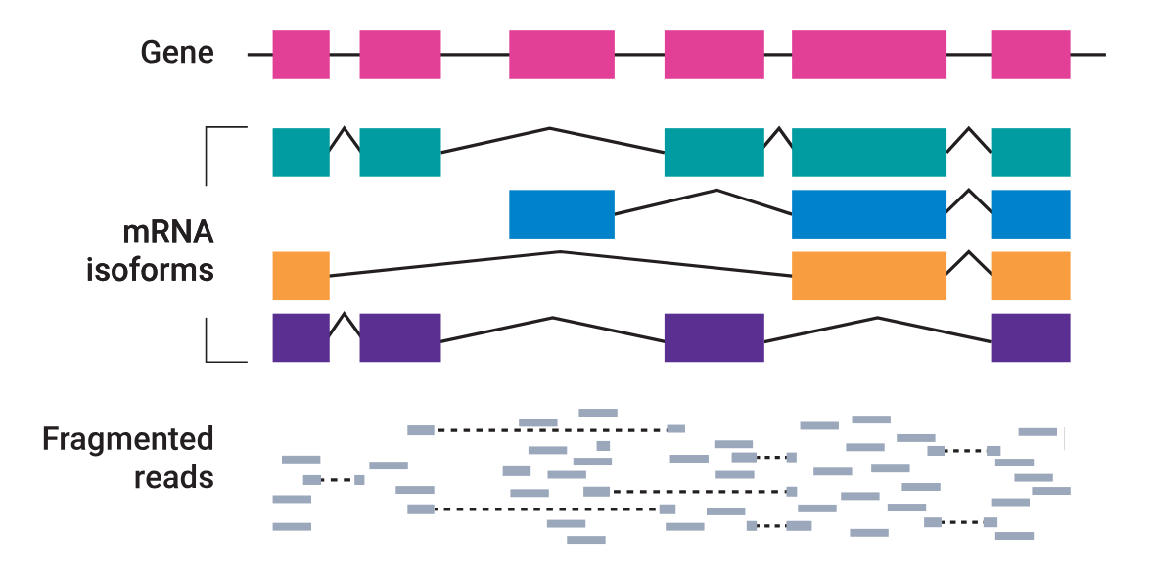
Isoforms
Isoforms make spliced mapping more complicated.
Not all reads can be assigned to a specific isoform.

Slide 38
Lecture Plan
Principles
Techniques
Microarrays
RNA-Seq
RNA-Seq library preparation
RNA selection/Depletion
Fragmentation
cDNA synthesis
Sequencing
Read Mapping
Counting Reads​
Pre-visualisation transformations​
Visualisation​
Heatmaps​
Principal Components Analysis​

Slide 39
Counting Reads
The next step is to count the number of reads mapping to each gene.
Seems trivial, can be complicated.

Slide 40
HTSeq-Count
For each position in the read, list every overlapping feature.
Modes:
Union: reads are assigned to every feature they overlap with.
Intersection_strict: reads are assigned only to the intersection of features they overlap with, including empty space
Intersection_nonempty: reads are assigned only to the intersection of features they overlap with, excluding empty space

Slide 41
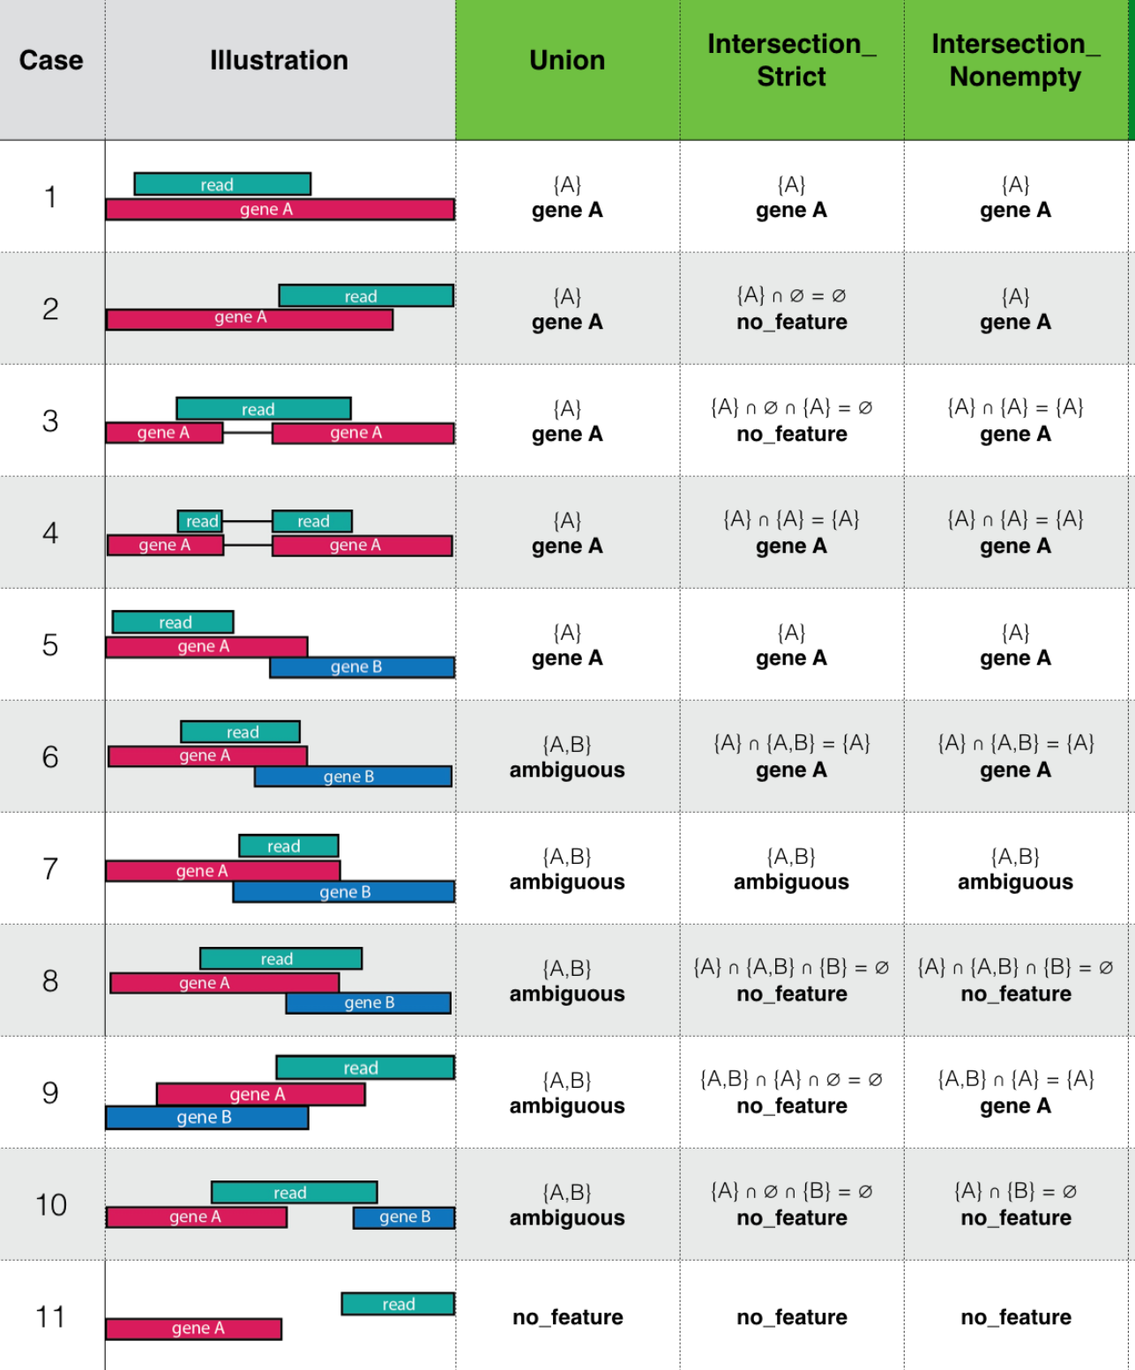
https://kim.bio.upenn.edu/software/verse_manual.html

Slide 42
https://kim.bio.upenn.edu/software/verse_manual.html

Slide 43
HTSeq-Count
--nonunique none (default)
Reads which map to more than one feature are counted as ambiguous
{A, B} = ambiguous
--nonunique all
Reads which map to more than one feature are counted as both
{A, B} = A and B

Slide 44
Counting Isoforms
The gene models need to allow for different isoforms for counts to be accurate

Slide 45
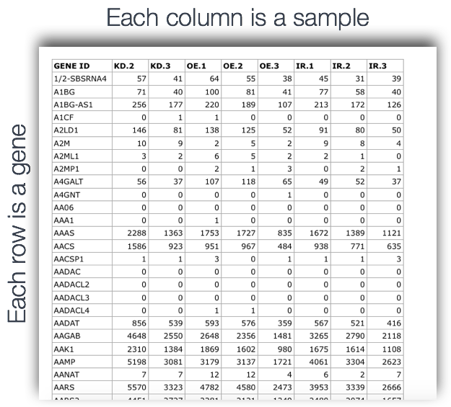
Counts Table
https://hbctraining.github.io/Intro-to-rnaseq-hpc-O2/img/count-matrix.png

Slide 46
Counts Table
RNA-seq gives us an estimation of relative expression of genes compared to others in the sample.
It doesn't give an absolute value to gene expression.

Slide 47
Lecture Plan
Principles
Techniques
Microarrays
RNA-Seq
RNA-Seq library preparation
RNA selection/Depletion
Fragmentation
cDNA synthesis
Sequencing
Read Mapping
Counting Reads​
Pre-visualisation transformations​
Visualisation​
Heatmaps​
Principal Components Analysis​

Slide 48
Counts Table Data Exploration
There are a few visualisations we can do at this point in order to establish:
The quality of the data for each sample.
How similar to or different from each other our samples are.

Slide 49
Pre-visualisation Transformation
Data is often transformed prior to generating these visualisations.
Transformations are only for these plots – we use the untransformed data as input to our normalisation step later.
Genes with higher expression levels will have higher variance
Transformed so that genes with different expression levels will have similar variance

Slide 50
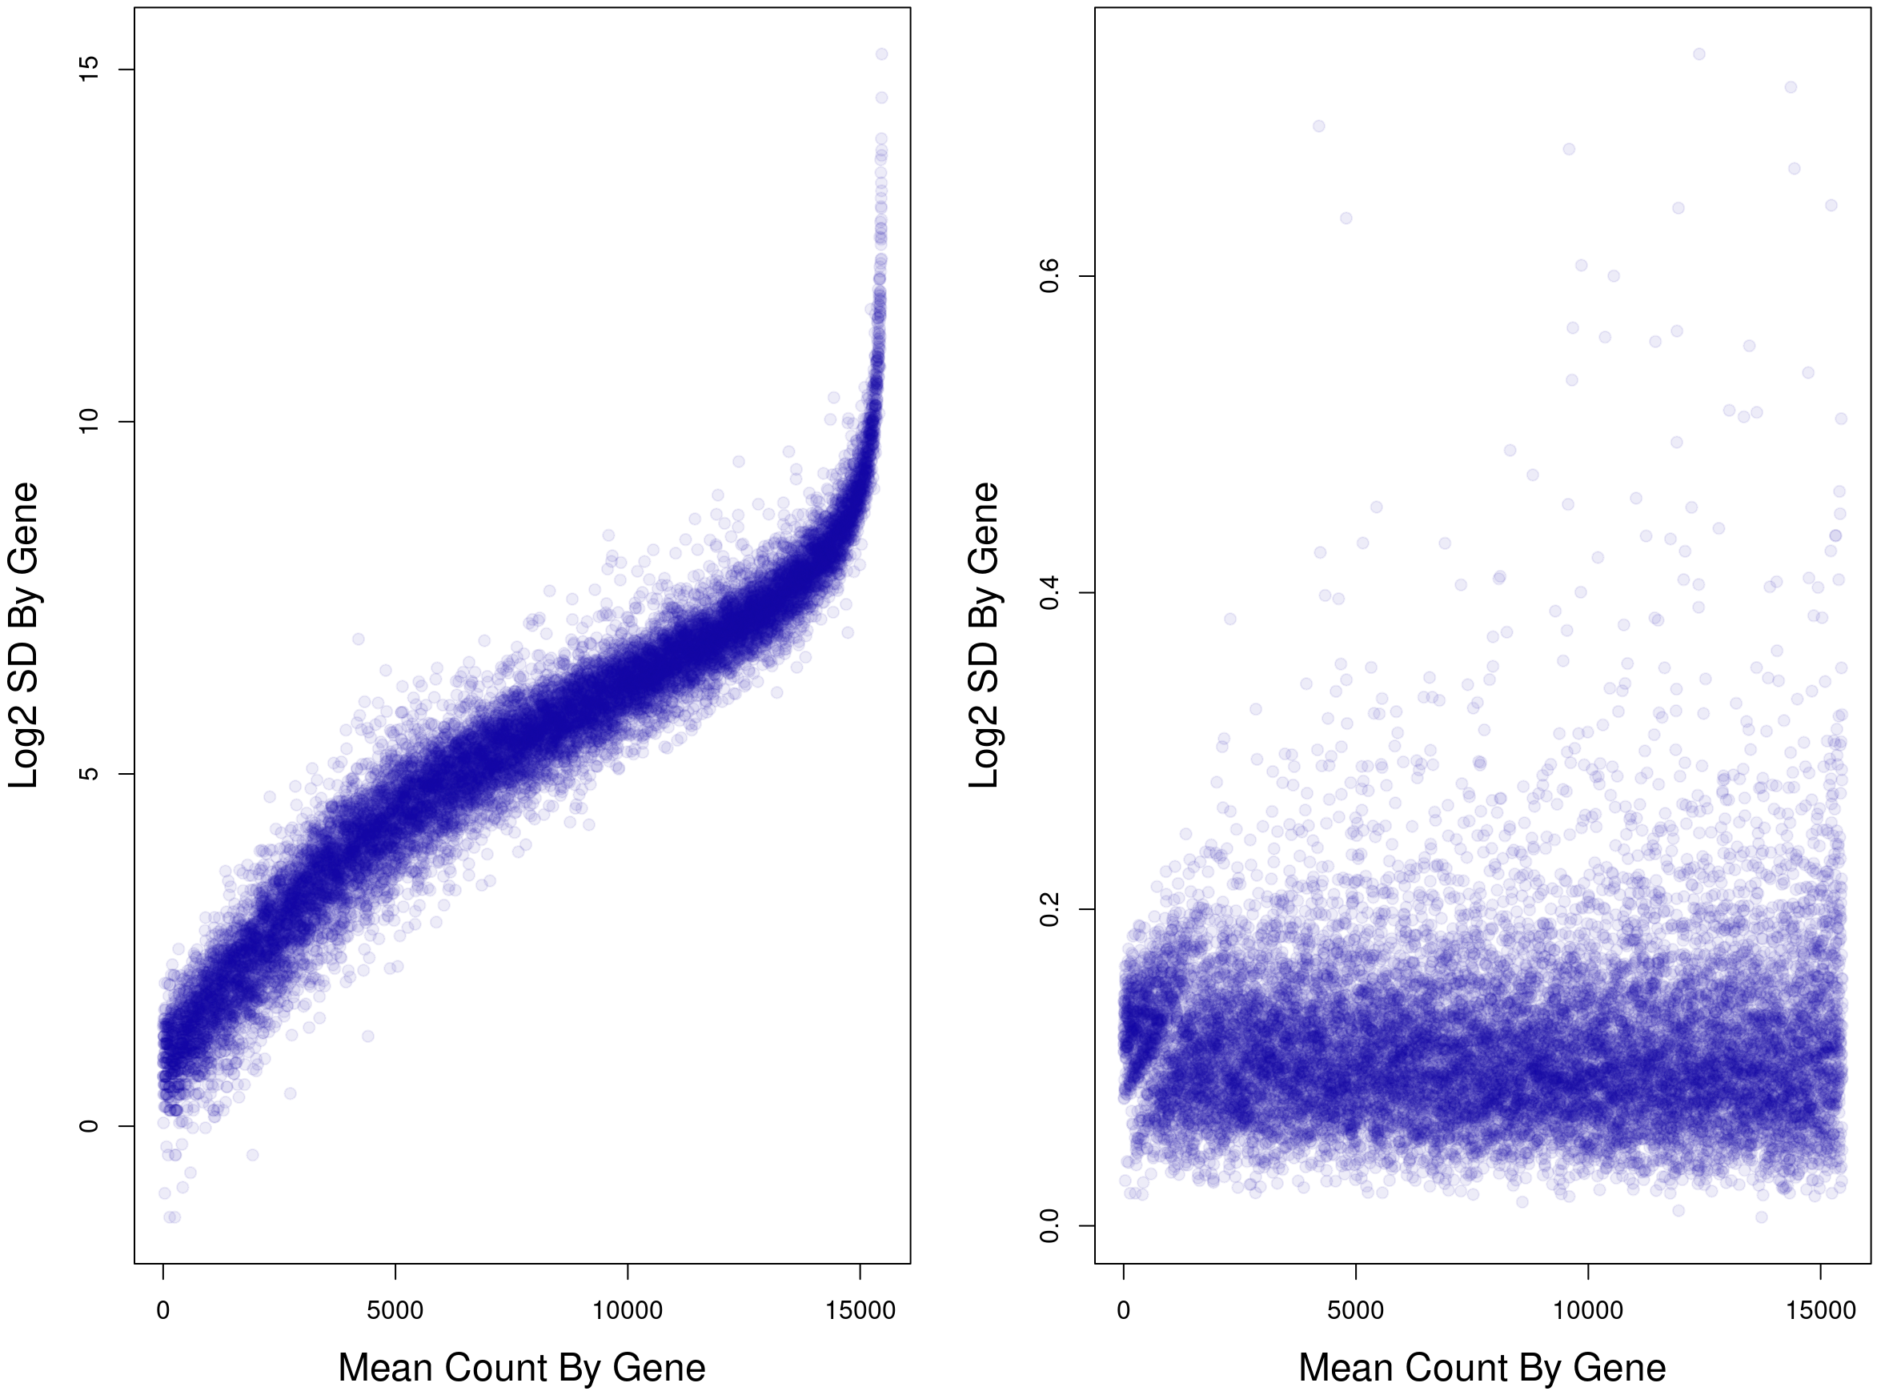
Variance Stabilising Transformation
Common option – variance stabilising transformation
Removes the dependence of the variance on the mean.
Can also use an rlog transformation.

Slide 51
Lecture Plan
Principles
Techniques
Microarrays
RNA-Seq
RNA-Seq library preparation
RNA selection/Depletion
Fragmentation
cDNA synthesis
Sequencing
Read Mapping
Counting Reads​
Pre-visualisation transformations​
Visualisation​
Heatmaps​
Principal Components Analysis​

Slide 52
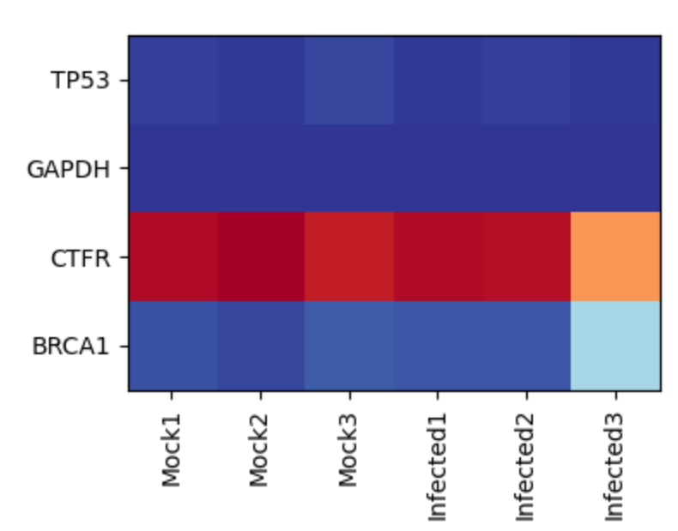
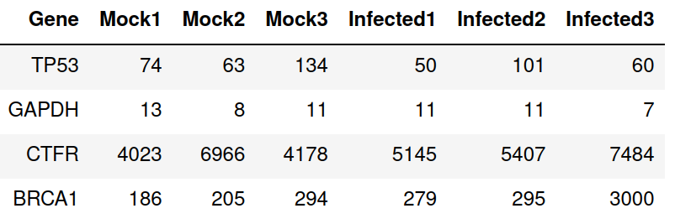
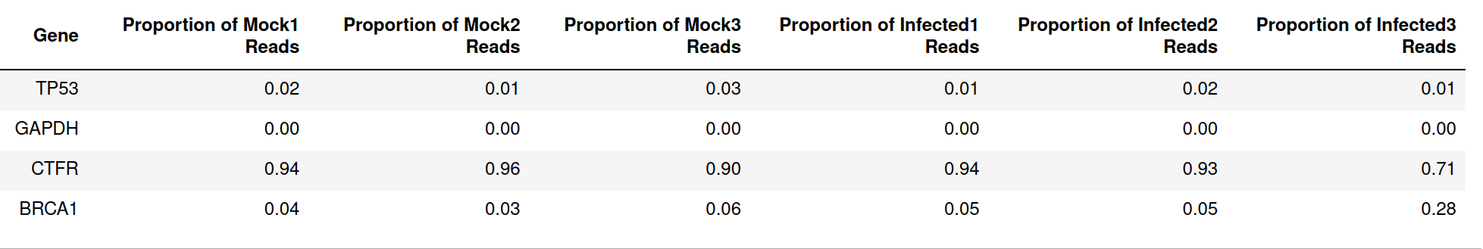
Gene Expression Heatmaps
It is common to look at the relative expression of specific genes in different samples.
This can be for highly expressed genes, random genes, or specific genes of interest.

Slide 53
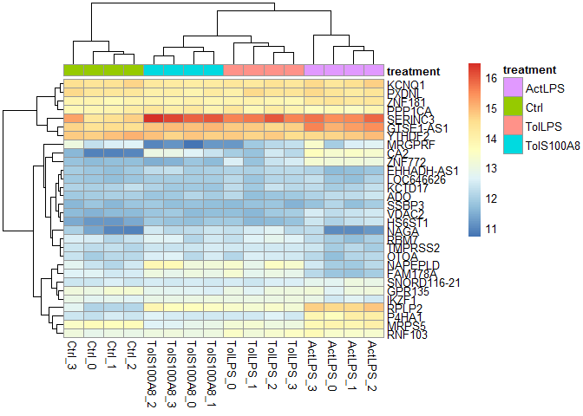
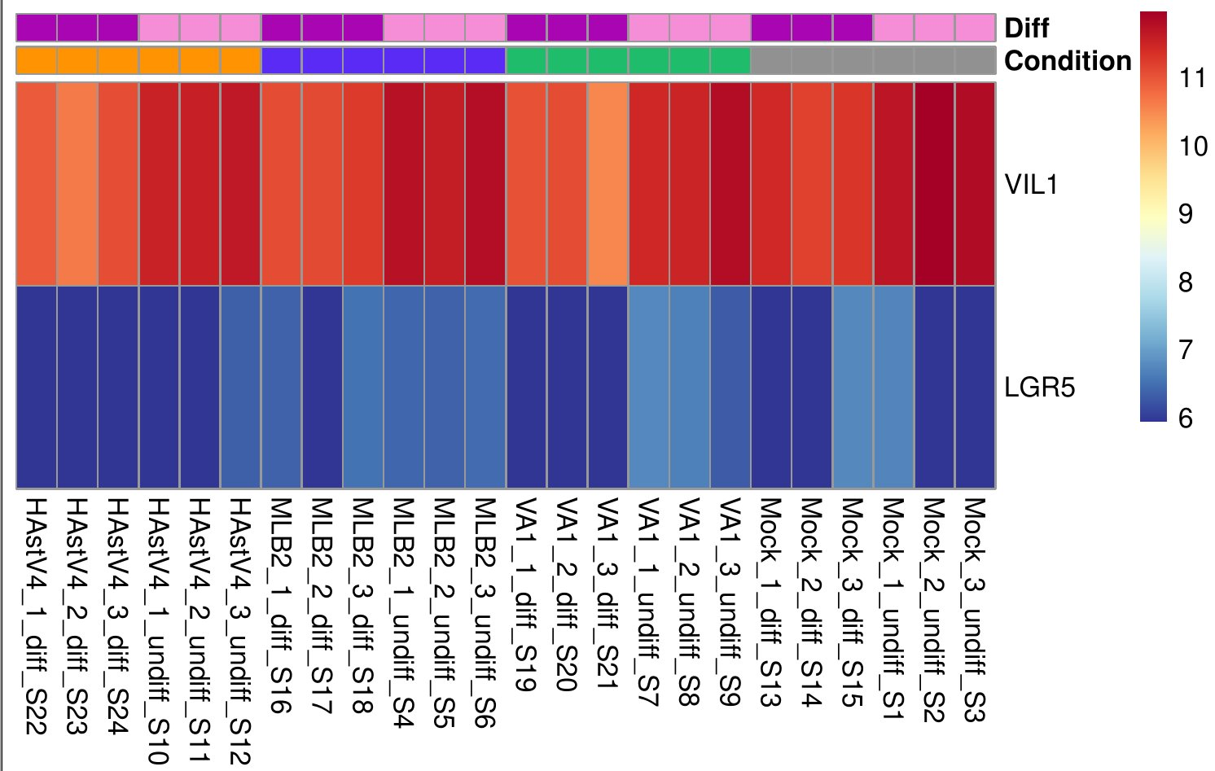
Gene Expression Heatmaps
https://shiring.github.io/rna-seq/deseq2/teaching/2016/09/29/DESeq2_course_blog_files/figure-markdown_github/heatmaps2-2.png

Slide 54
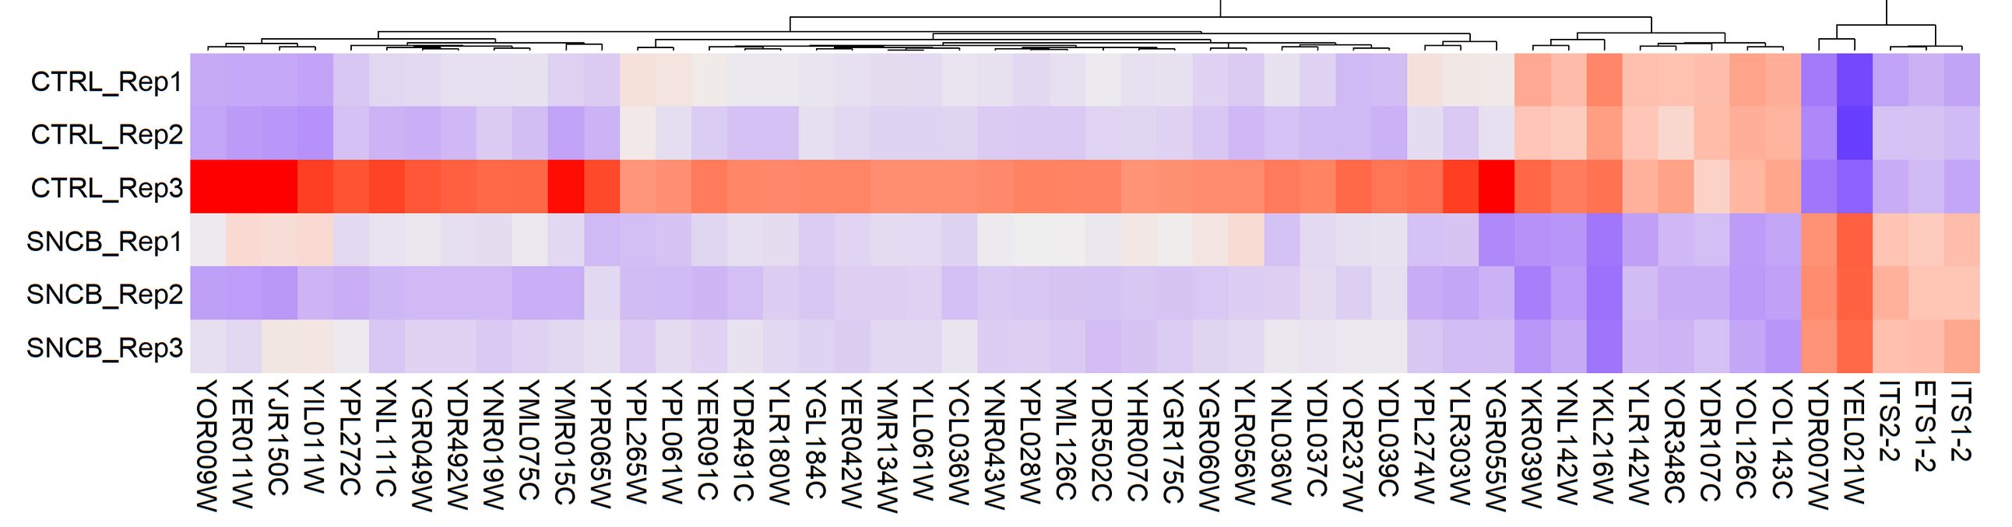
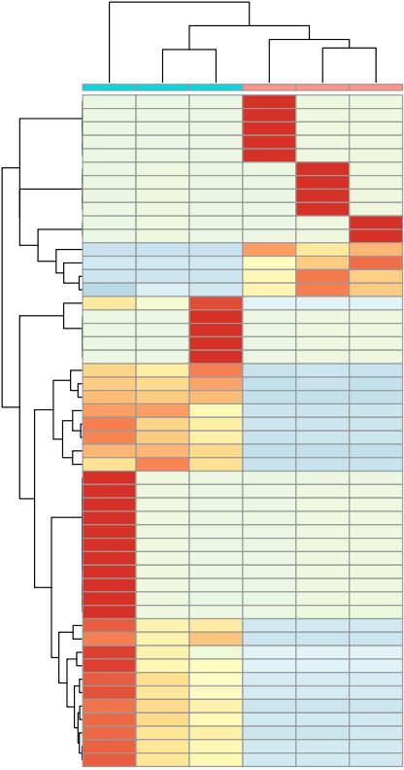
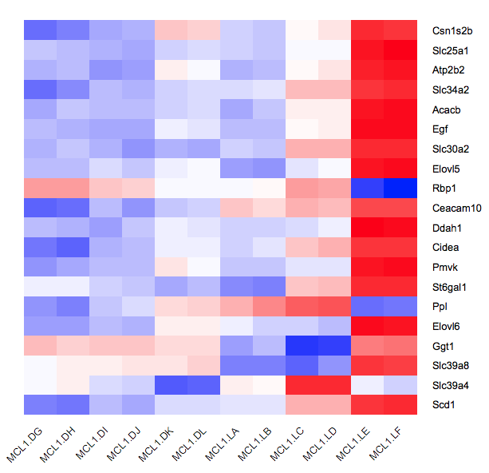
Gene Expression Heatmaps
Sometimes one sample will look very different from the others – can be a sign of a problem.
https://support.bioconductor.org/p/9146960/
https://training.galaxyproject.org/training-material/topics/transcriptomics/tutorials/rna-seq-viz-with-heatmap2/tutorial.html
https://support.bioconductor.org/p/106505/

Slide 55
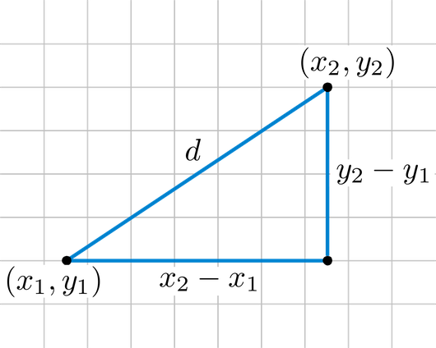
Sample Similarity Heatmaps
It's also common to calculate a similarity matrix, showing how similar samples are to each other.
Similarity / distance can be measured in various ways:
Pearson / Spearman correlation coefficient
Euclidean distance
Represent the distance as a heatmap.
Shows how the samples cluster.
https://rosalind.info/glossary/euclidean-distance/

Slide 56
Sample Similarity Heatmaps
Remember to be aware of whether you have a similarity or distance matrix:
Similarity – bigger numbers – more similar
Distance – bigger numbers – more different

Slide 57
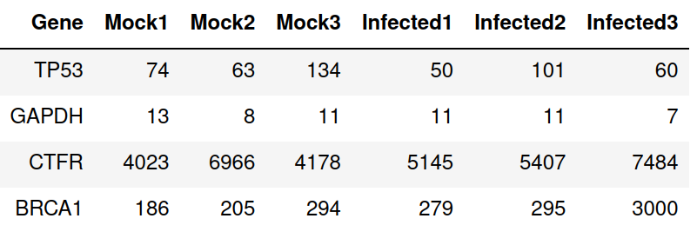
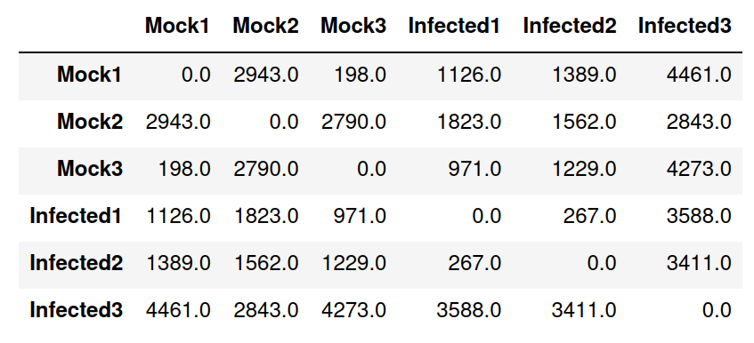
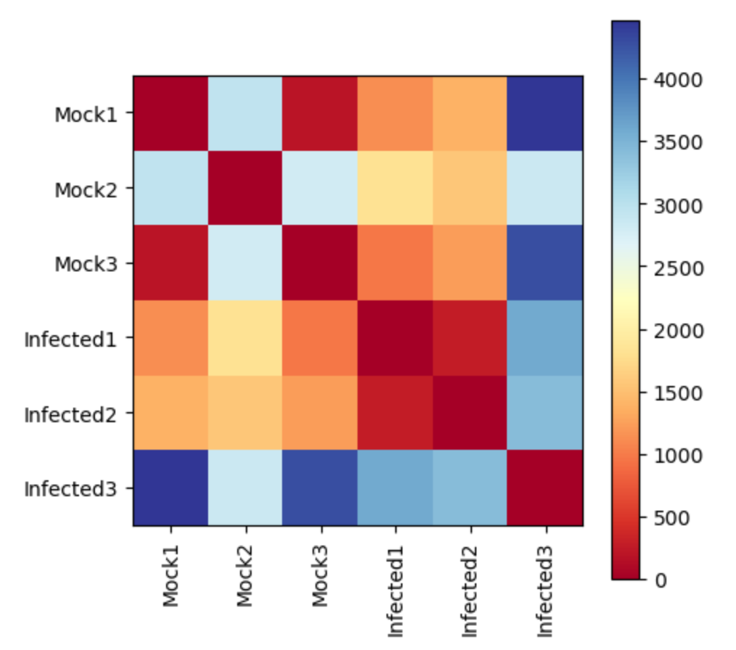
Sample Similarity Heatmaps
Counts table
Euclidean distance matrix
Heatmap

Slide 58
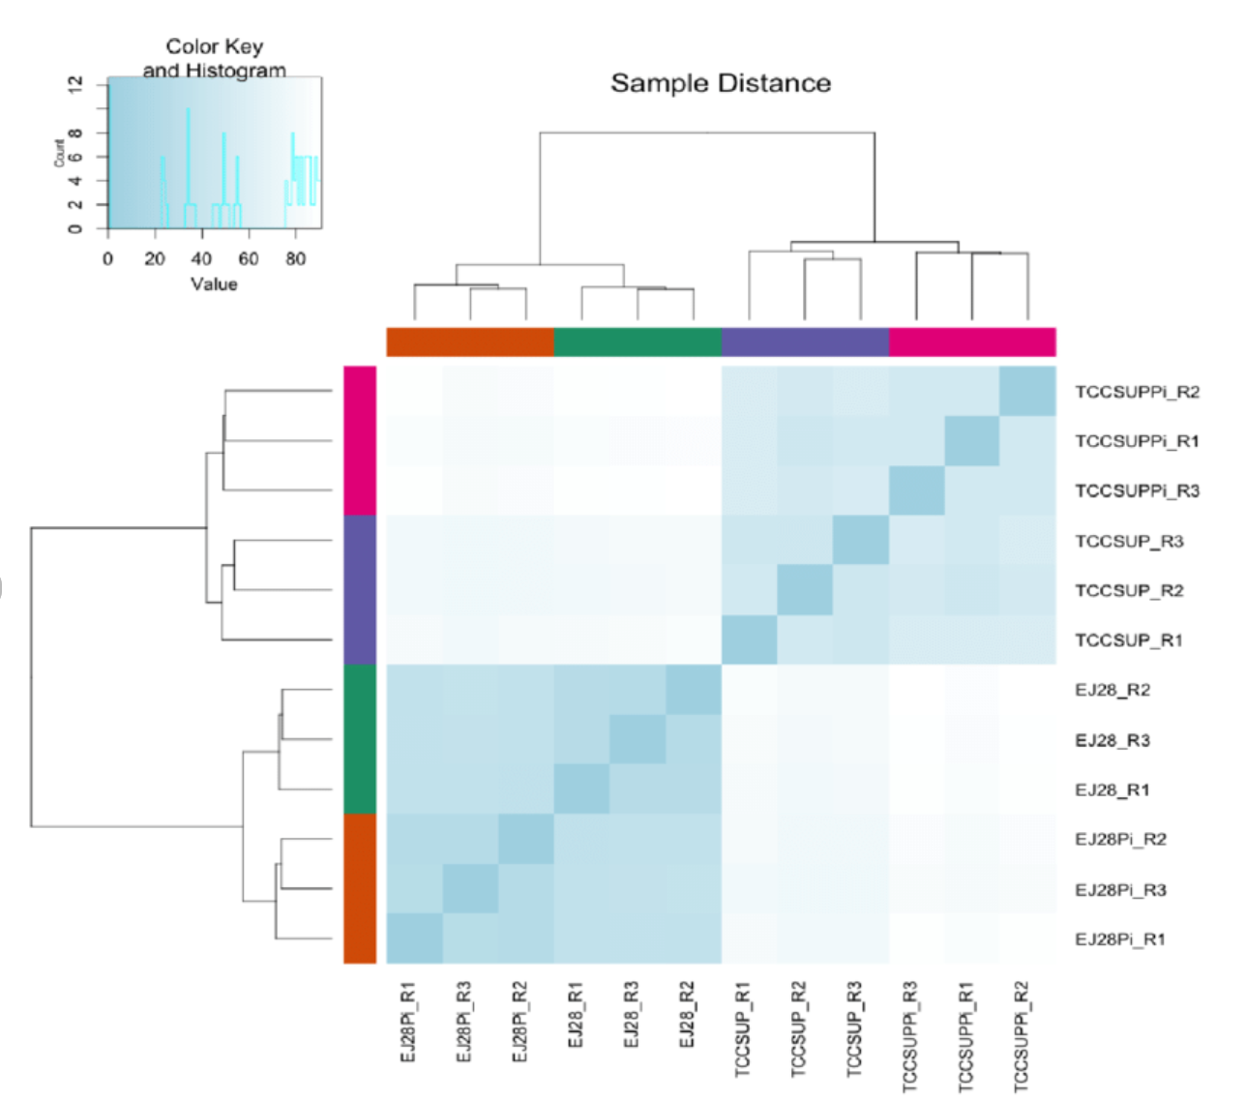
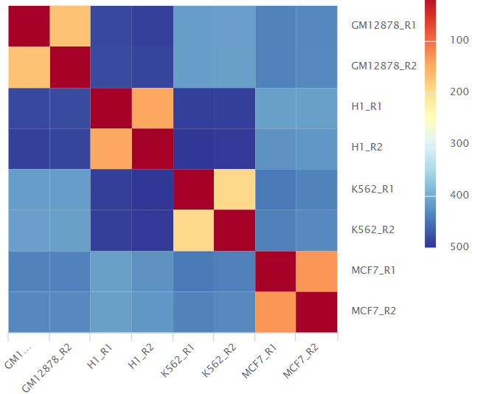
Sample Similarity Heatmaps
https://nf-co.re/rnaseq/3.1/docs/output/
https://www.biorxiv.org/content/10.1101/2020.12.14.422610v2

Slide 59
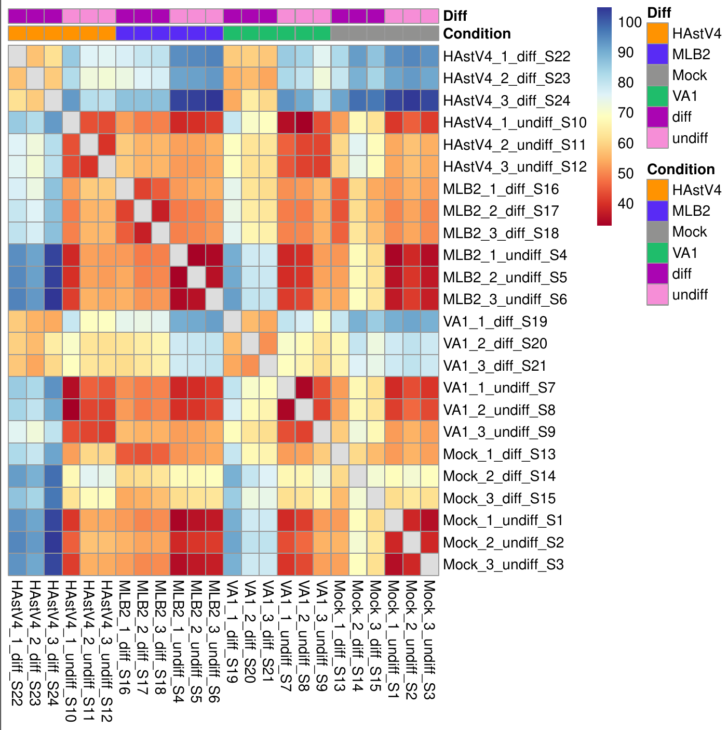
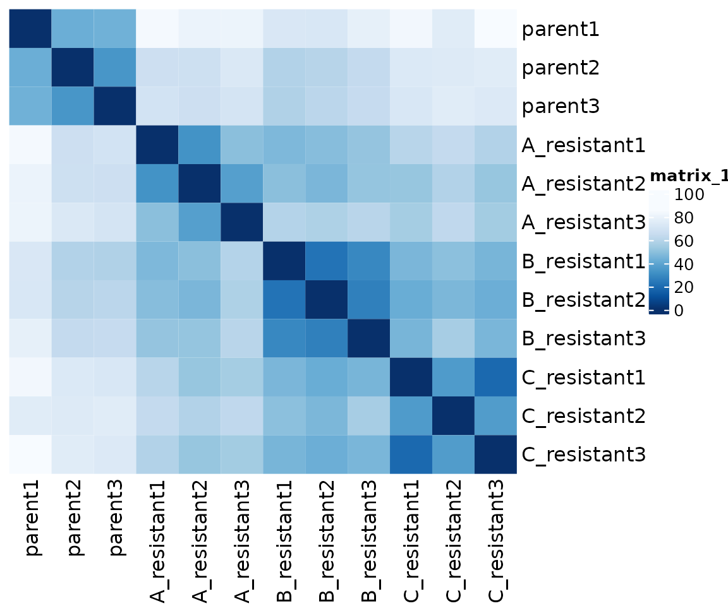
Sample Similarity Heatmaps
https://rnabioco.github.io/practical-data-analysis/articles/class-11_files/figure-html/unnamed-chunk-5-1.png

Slide 60
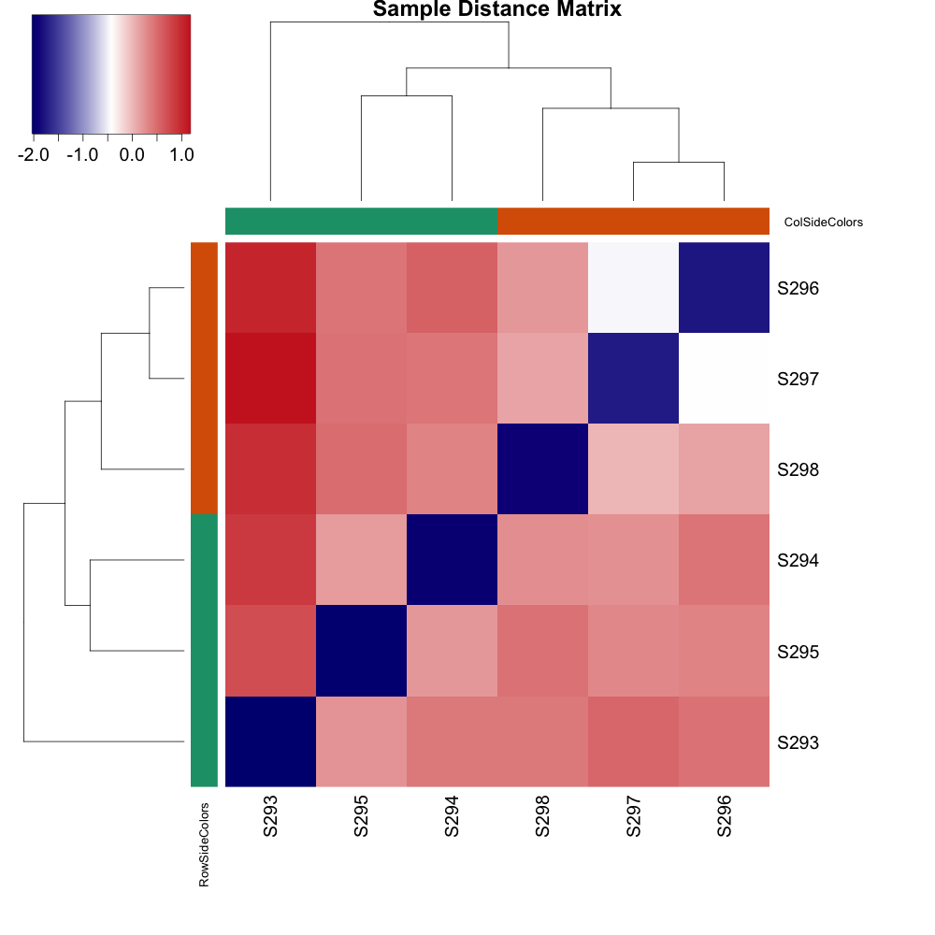
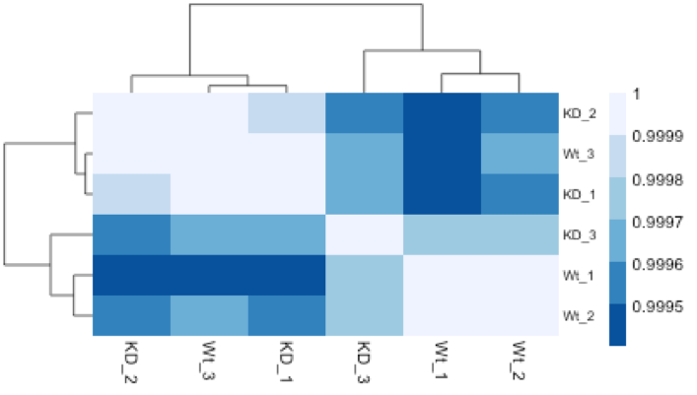
Sample Similarity Heatmaps
https://hbctraining.github.io/Training-modules/planning_successful_rnaseq/lessons/sample_level_QC.html
https://bioinformaticsworkbook.org/dataAnalysis/RNA-Seq/RNA-SeqIntro/Differential-Expression-Analysis.html#gsc.tab=0

Slide 61
Lecture Plan
Principles
Techniques
Microarrays
RNA-Seq
RNA-Seq library preparation
RNA selection/Depletion
Fragmentation
cDNA synthesis
Sequencing
Read Mapping
Counting Reads​
Pre-visualisation transformations​
Visualisation​
Heatmaps​
Principal Components Analysis​

Slide 62
Principal Components Analysis (PCA)
Another method to show how the samples cluster.
Gene expression data is multidimensional.
Each gene is a dimension – in theory you could plot a scatter plot with one dimension for each gene.
PCA aims to reduce the dimensionality of the data so that it can be shown on a single axis.

Slide 63
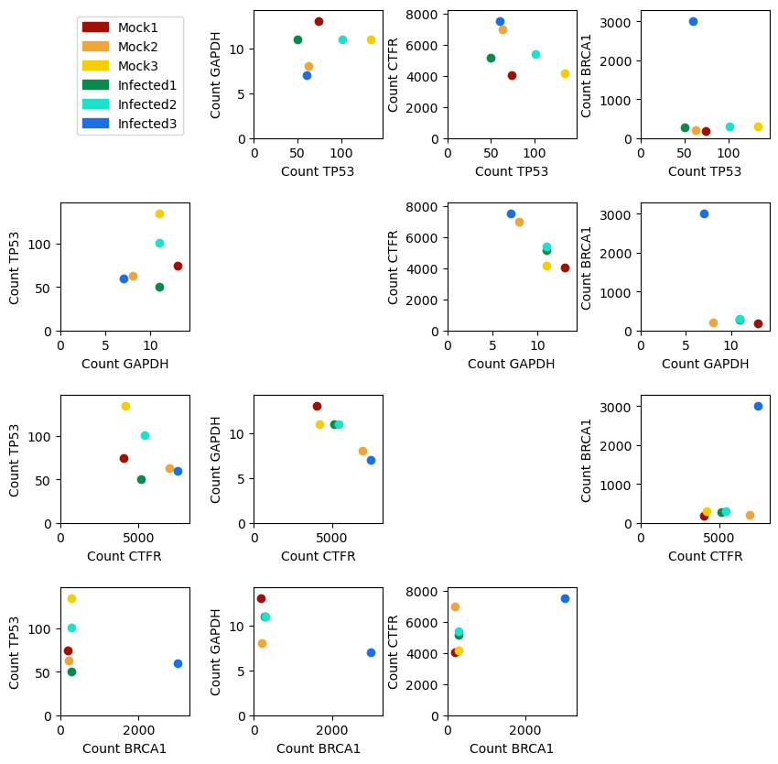
Principal Components Analysis
Samples can be placed in space based on gene counts.

Slide 64
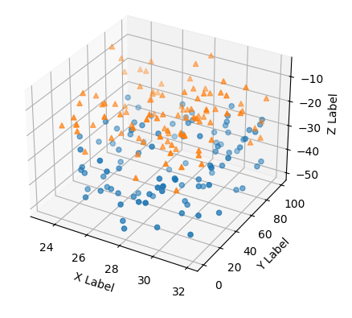
Principal Components Analysis
Beyond 3 genes visualisation as a scatter plot becomes impossible.
PCA allows us to reduce the thousands of variables into fewer variables which still explain most of the variation in the sample.
Gene 3
Gene 2
Gene 1

Slide 65
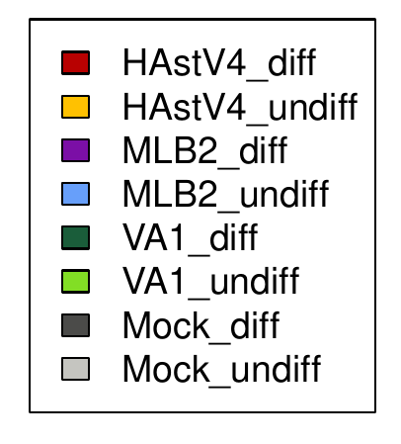
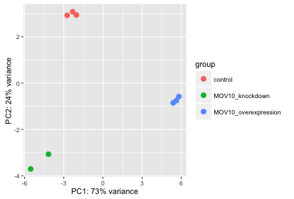
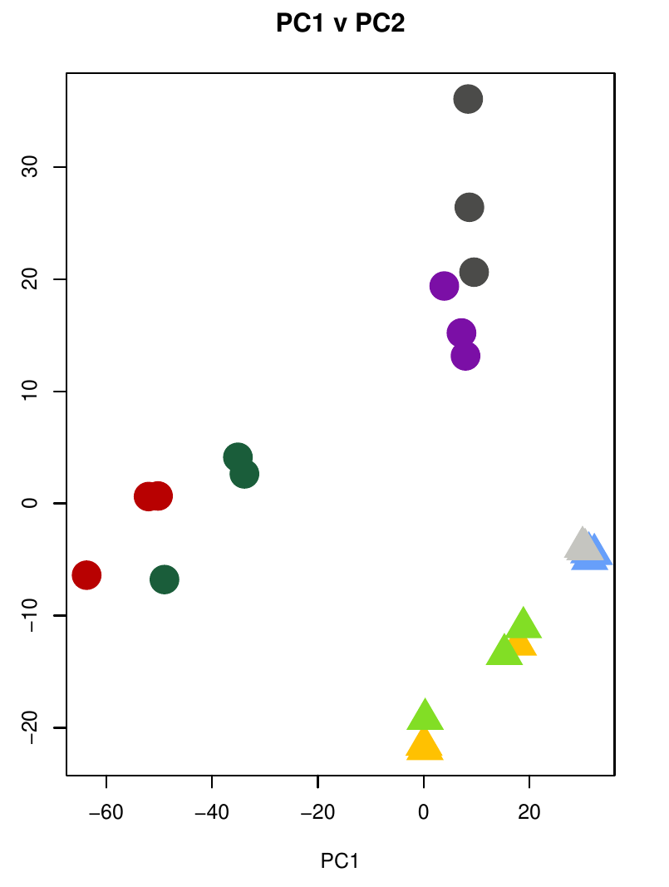
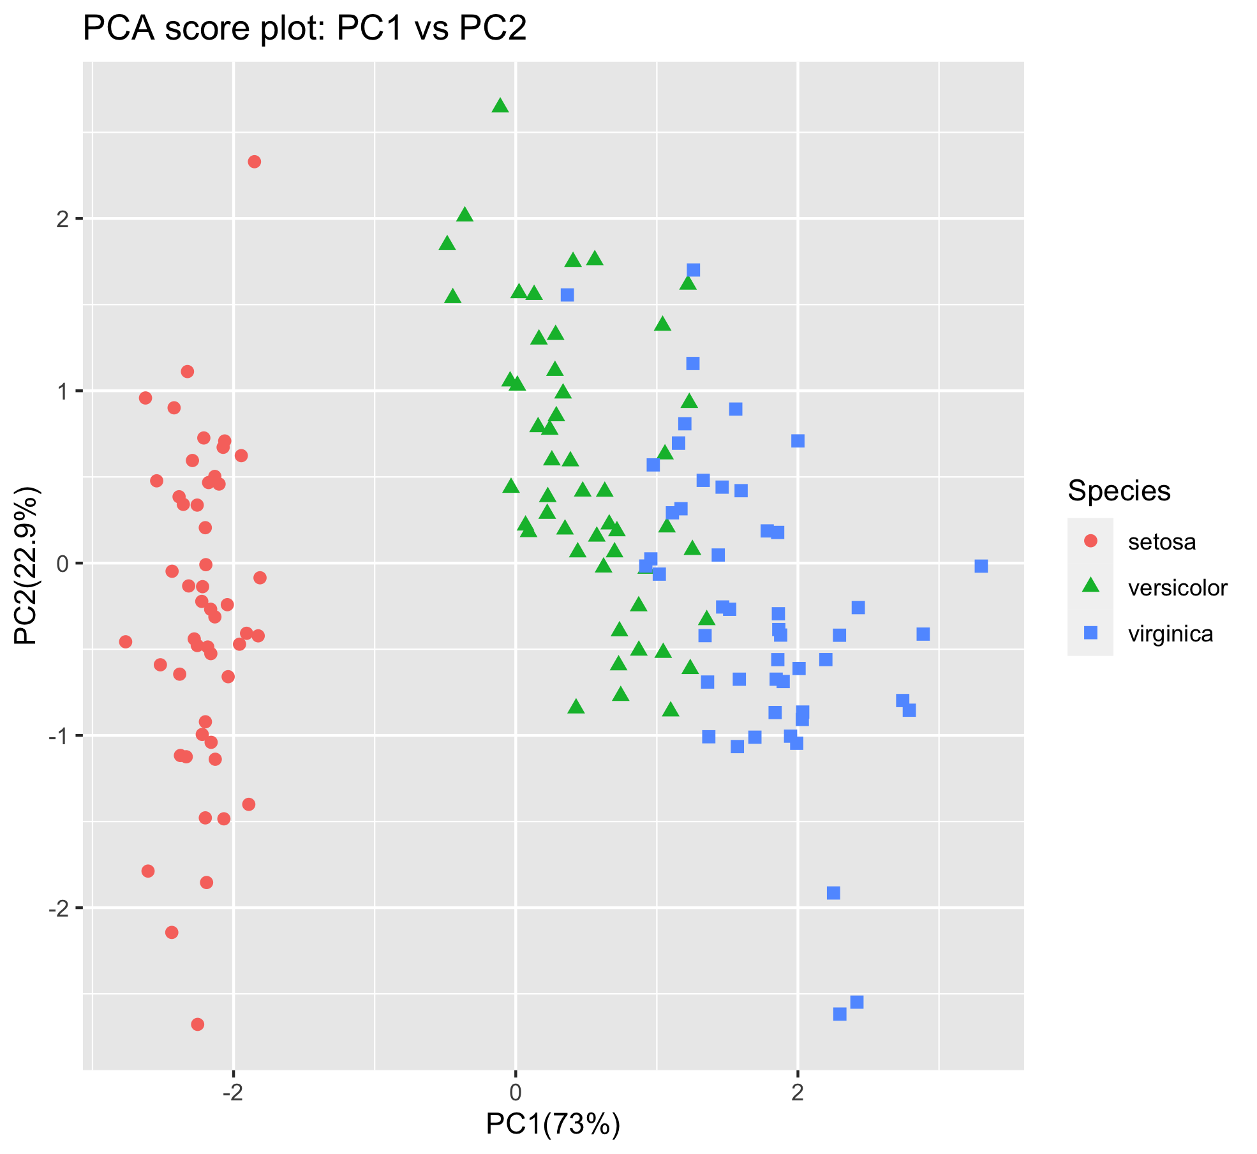
Principal Components Analysis
https://hbctraining.github.io/DGE_workshop/lessons/03_DGE_QC_analysis.html
https://scienceparkstudygroup.github.io/rna-seq-lesson/05-descriptive-plots/index.html

Slide 66
Batch Effects
A PCA can be a very useful way to identify batch effects.
Batch effects: sources of variation besides biological differences
e.g.
Sample preparation date
Sequencing centre
Researcher
It can be possible to correct for batch effects but samples from different conditions need to be in different batches.

Slide 67
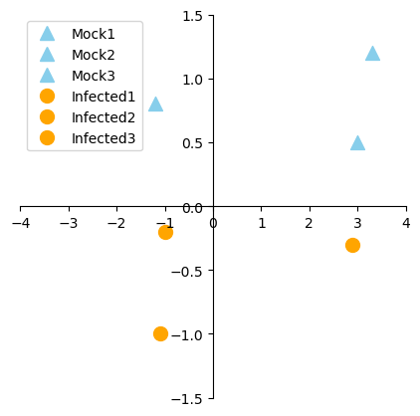
Batch Effects
e.g.
Batch 1 - Researcher 1, Day 1: Mock1, Mock2, Mock3
Batch 2 - Researcher 2, Day 2: Infected1, Infected2, Infected3
We can see that the samples don't cluster well by condition but we can't do anything about it.

Slide 68
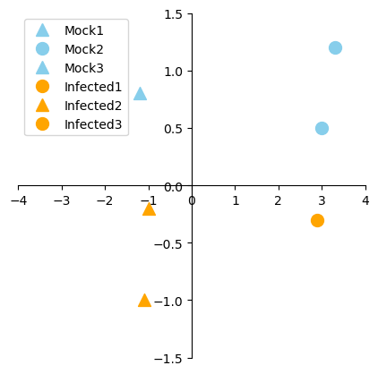
Batch Effects
e.g.
Batch 1 - Researcher 1, Day 1: Mock1, Infected2, Mock3
Batch 2 - Researcher 2, Day 2: Mock2, Infected1, Infected3
We can see that the samples cluster primarily by batch and correct for it.

Slide 69


Principal Components Analysis
We will go through an example PCA step by step.
In this example we just have two genes (so we don't really need a PCA).
Josh Stamer, StatQuest https://www.youtube.com/watch?v=FgakZw6K1QQ

Slide 70

Principal Components Analysis
First we centralise our data for each gene so that the mean is 1.
Subtract the mean for each gene from the counts.
e.g. Gene 1 mean = 5.83
Gene 1 Mouse 1 = 10 – 5.83 = 4.17
Gene 1 Mouse 2 = 11 – 5.83 - 5.17

Slide 71

Principal Components Analysis
We then draw a line through the data which passes through the origin (0, 0).
This example is an arbitrary line.

Slide 72




Principal Components Analysis
The data is projected onto this line, by finding the nearest point to each data point on the line.
(1.77, 1.77)
m = slope of the line
x₀ = position of point on x-axis
y₀ = position of point on y-axis
Here the slope is 1
(2.17 + 1.37) / (1 + 1) = 1.77
1 * 1.77 = 1.77

Slide 73



Principal Components Analysis
We then calculate the distance between each projected point and the origin.

Slide 74


Principal Components Analysis
This distance (d) from the origin is calculated for each of the projected points.
The total variance explained by this line is calculated as the sum of squares of these values.
d_{i} is the distance from each projected point to the origin, n is the number of data points (6).
This is known as the eigenvalue for the line.
The distances are squared so that negative values don't cancel out positive values.

Slide 75

Principal Components Analysis
For this line:
d d²
= sum(d²) / 5
= 87.67 / 5
= 17.53
This line would explain a total variance of 17.53
eigenvalue = 17.53

Slide 76

Principal Components Analysis
The line through the origin which maximises the total variance explained is identified.
In our case it is this line, with a slope of 0.25.

Slide 77


Principal Components Analysis
Project the points onto the line.
Calculate the distance between the points and the origin.

Slide 78

Principal Components Analysis
d d²
= sum(d²) / 5
= 105.44 / 5
= 17.53
This line would explain a total variance of 21.09
eigenvalue = 21.09
This is the highest variance for any line for this sample – this is PC1.

Slide 79


Principal Components Analysis
The slope of this line is 0.25 - so gene 1 accounts for 4 times more variance in this PC than gene 2.

Slide 80

Principal Components Analysis
It is usual to convert the line to a single unit in length to give the eigenvector for the principal component.
The relative contribution to the eigenvector of each gene is known as the loading.
Loading gene 1: 0.97
Loading gene 2: 0.24

Slide 81

Principal Components Analysis
Since we only have two genes, PC2 is just the line which is perpendicular to PC1 and passes through the origin.

Slide 82


Principal Components Analysis
We can calculate the variance attributed to PC2 as we did for PC1.

Slide 83

Principal Components Analysis
We can calculate the variance attributed to PC2 as we did for PC1.
d d²
= sum(d²) / 5
= 5.03 / 5
= 1.006
This line explains a total variance of 1.006
eigenvalue = 1.006

Slide 84

Principal Components Analysis
We then plot our projections onto PC1 against our projections onto PC2.
Since we only have two genes and therefore a maximum of 2 principal components, our PCA is now complete.

Slide 85
Principal Components Analysis
The total variance across the counts table is 22.09, with 21.09 accounted for by PC1 and 1.00 accounted for by PC2.
Therefore PC1, accounts for 95% of variance between samples and PC2 for 5%.
For a real analysis, a value of ~35% or more for PC1 is considered good.

Slide 86

Principal Components Analysis
When we have 3 genes,
PC2 is the best fitting line which is perpendicular to PC1 and passes through the origin.
PC3 is the line which is perpendicular to PC1 and PC2 and passes through the origin.

Slide 87
Principal Components Analysis
We can continue this up to any number of genes.
The PCA will capture how multiple genes are impacting the clustering of the samples in a single plot.
We can also plot the loadings to show how much different genes are contributing to our principal components.

Slide 88
Conclusions
Differential expression aims to identify genes which are significantly more expressed in one condition than another.
Transcription is used as as proxy
Expression is relative to other genes in the sample
Microarrays were used for differential expression in the past, RNA-seq is now more common.
RNA-seq library prep can involve polyA selection or ribosome depletion.
Mapping RNA-seq data requires awareness of splice junctions
The number of reads per gene can be counted in various ways
Data should be transformed prior to visualisation
Heatmaps can give us an idea as to the quality of our data
PCA reduces the dimensionality of the data and allows complex datasets to be summarised

